Slide 1
I say what I see
Implementation of image caption generator model
Info 7375 final project
Prof. Subrata das
Author: Indupriya kompi Sadasivappa
Nuid: 001051831

Slide 2
TABLE OF CONTENTS
INTRODUCTION
PROBLEM STATEMENT
APPLICATIONS/RELATED WORK
PRE-REQUISITES
DATA SOURCE COLLECTION AND DESCRIPTION
UNDERSTANDING THE DATA
MODEL ARCHITECTURE-HIGH LEVEL
MODEL IMPLEMENTATION
DATA PREPARATION
DATA GENERATOR
WORD EMBEDDING
ENCODER-DECODER MODEL
HYPERPARAMETER TUNING AND TRAINING
EVALUTION
CONCLUSION AND FUTURE DIRECTIONS
REFERENCES

Slide 3

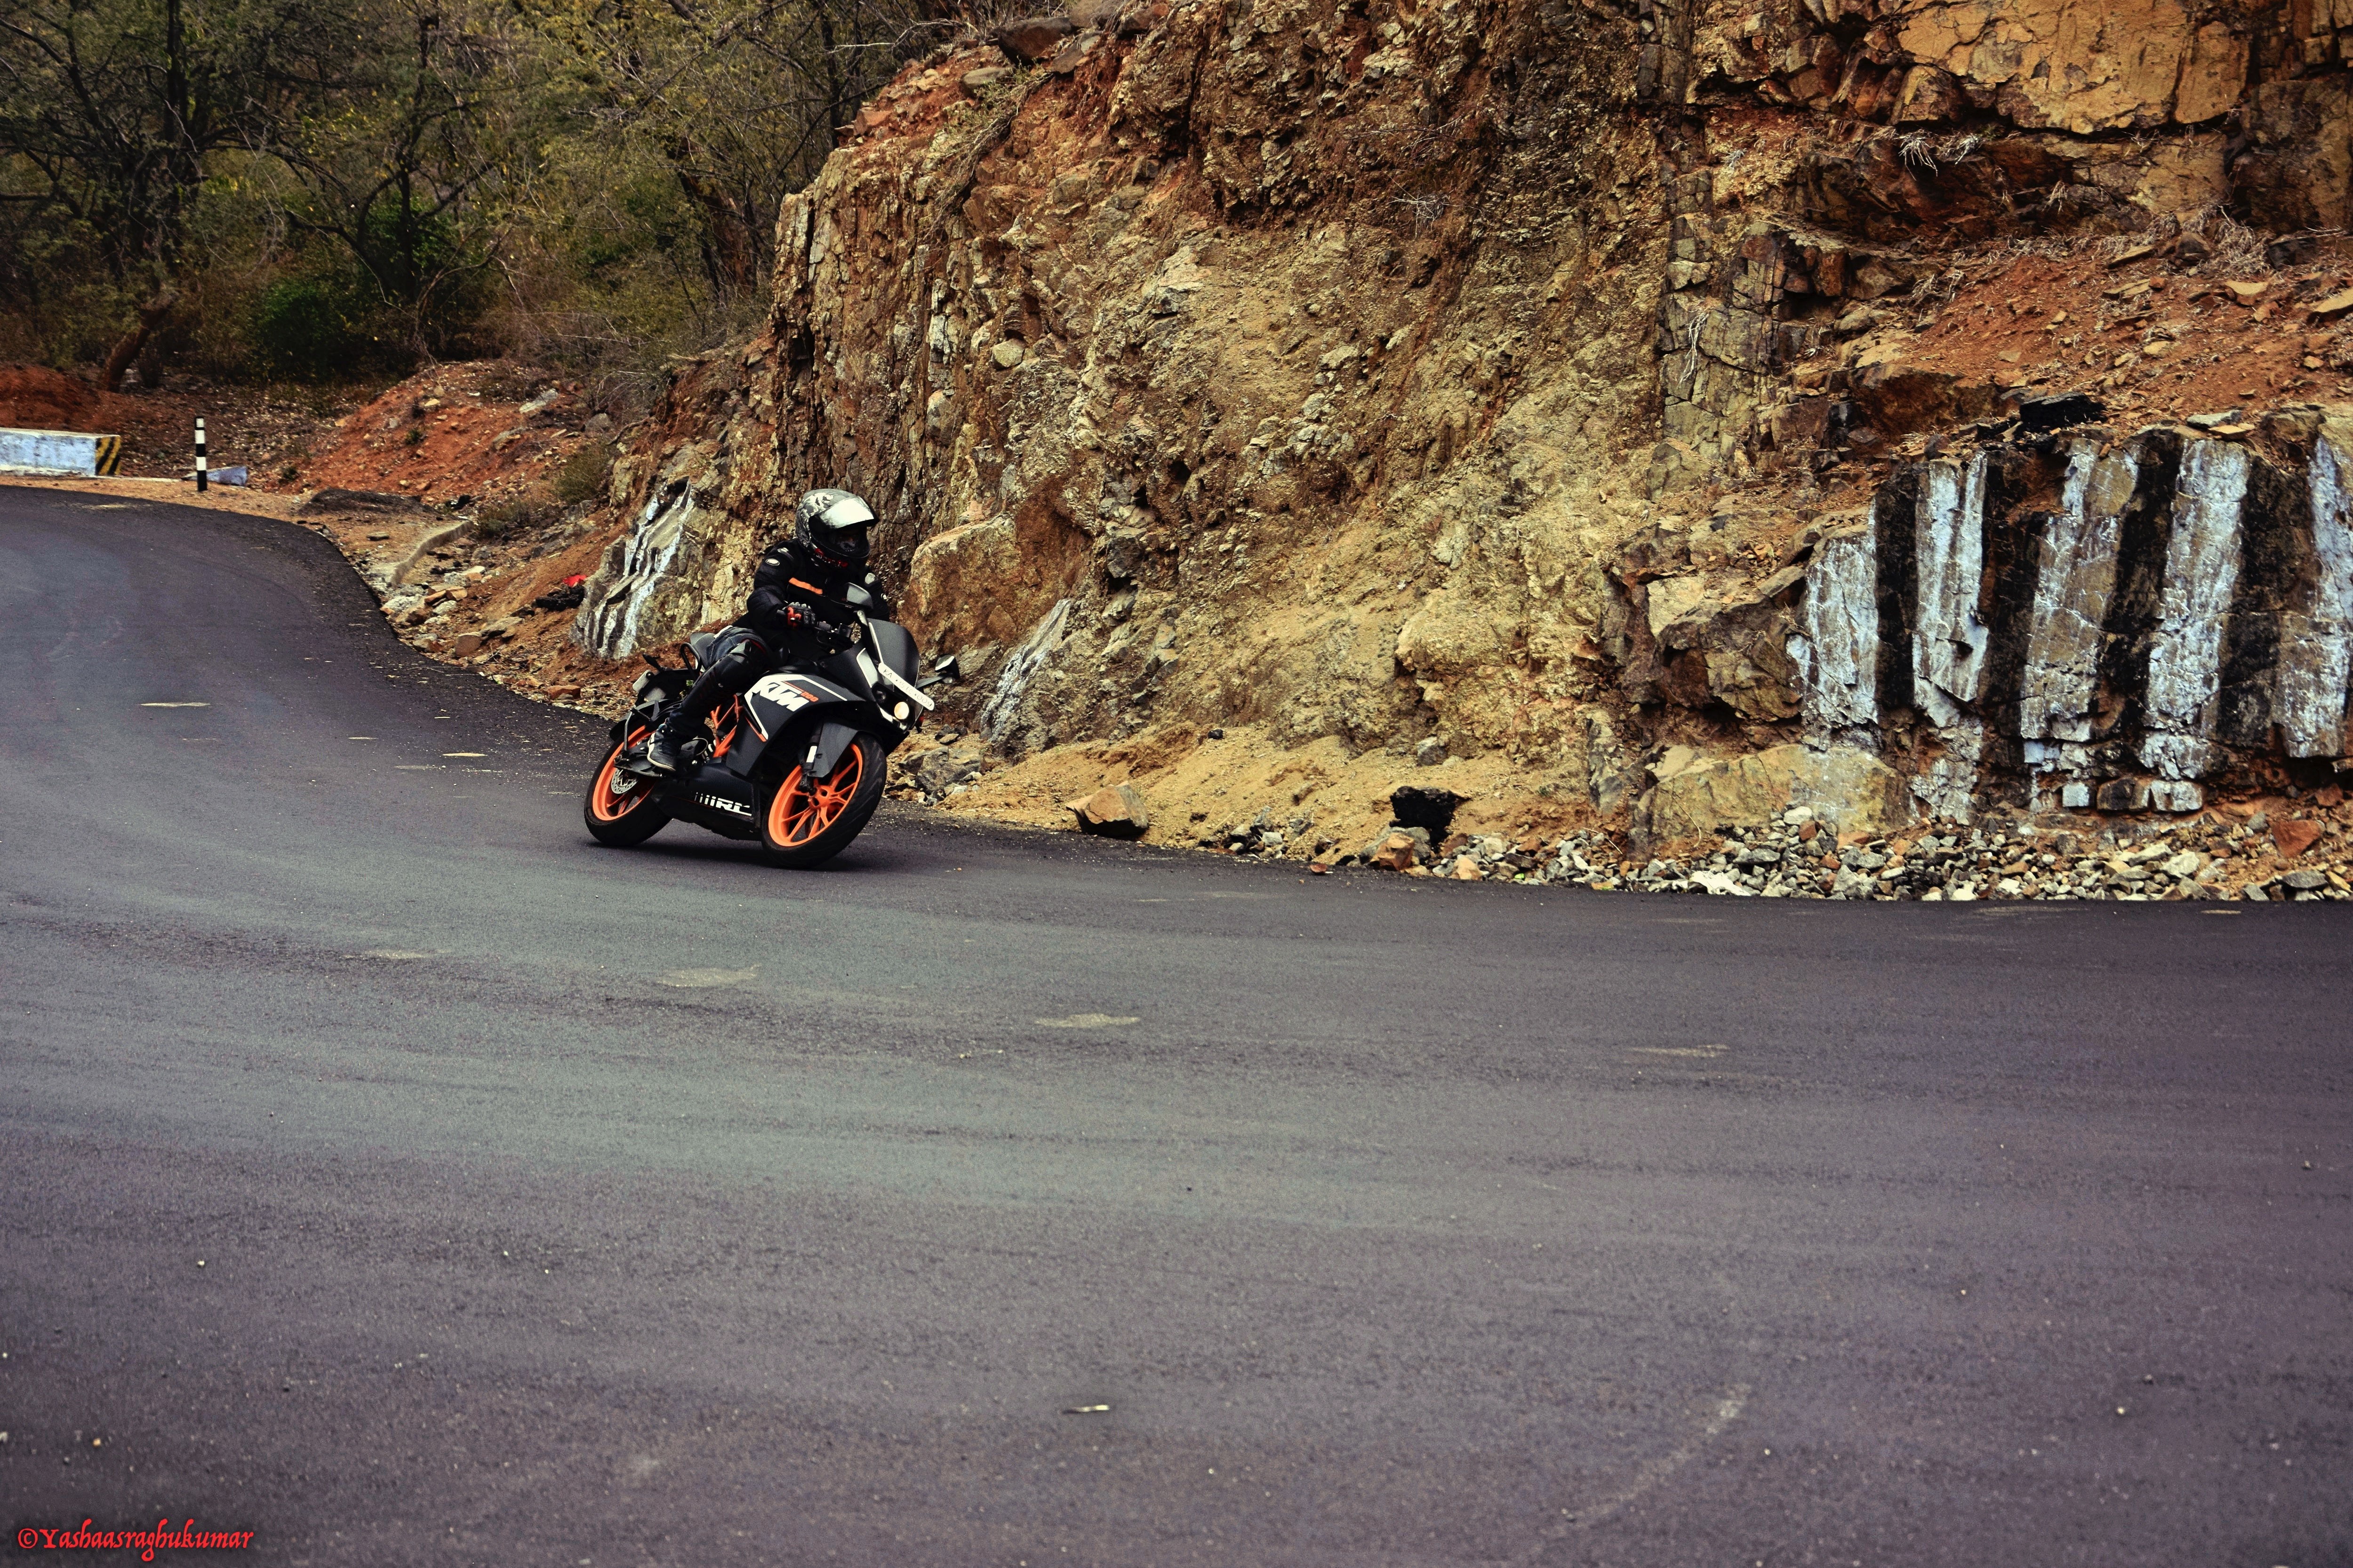
INTRODUCTION
What do you see?
Well, I see a biker riding a motorcycle. How do you put it?
It is quite easy and comes naturally to humans. We can describe a picture in any language that we want.
But I wonder if a computer can do the same, if taught? Let’s see

Slide 4
PROBLEM STATEMENT
The objective is to develop a complex deep learning encoder-decoder model that automatically generates the human-readable textual descriptions for a given image.
It involves the integration of computer-vision to understand the contents of the image and language model(NLP) to turn this understanding of images to texts.

Slide 5
APPLICATIONS
Before we hop on to building the model. It is essential to understand the real-world scenarios. A few of many applications of an image captioning models are:
Self-driving cars: Automatic driving is one of the biggest challenges and if we can properly caption the scene around the car, it can give a boost to the self driving system
Aid to the blind: NVIDIA is using image captioning technologies to create an application to help people who have low or no eyesight
CCTV surveillances: CCTVs are everywhere and widely used. Along with viewing, it can be enabled to generate captions. This could probably help reduce some crime and/or accidents.
Military: Can be widely used in military to describe the contents and notify the military in the case of irregular/unexpected scenarios immediately.

Slide 6
ENABLING TECHNOLOGIES
CONCEPTS:
Familiarity with basic
Deep Learning concepts: CNN, Transfer Learning, RNN(LSTM)
Language Model: Text processing, Language, word embedding
Python programming, Keras library

Slide 7
DATA SOURCE COLLECTION AND DESCRIPTION
I have used Flickr8k dataset(size 1 GB). MS-COCO and Flickr30K are other datasets that you can use. The reason is because it is realistic and relatively small so that you can download it and build models on your workstation using a CPU.
Flickr8K has 6000 training images, 1000 validation images and 1000 testing images. Each image is given 5 different captions by 5 different humans. This is because an image can be described in multiple ways. These captions are stored in 'Flickr8k.token.txt'.
Find the link to Flickr8k dataset here and here

Slide 8
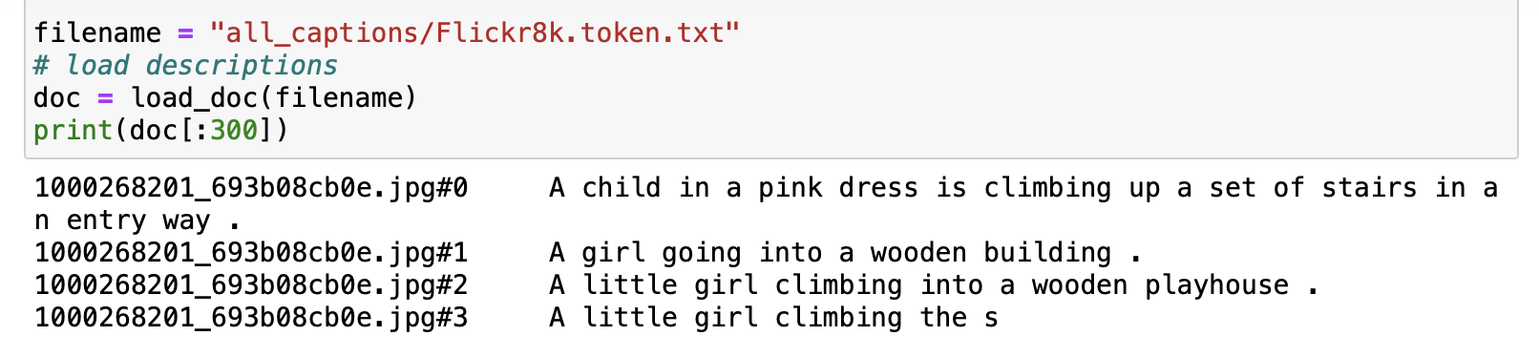
UNDERSTANDING THE DATA
If downloaded data from the link provided, one of the files is “Flickr8k.token.txt” which contains the name of each image along with its 5 captions. We can read this file as shown above.
Every line contains the <image name>#i <caption>, where 0≤ i ≤ 4 i.e., the name of the image, caption number (0 to 4) and the actual caption

Slide 9
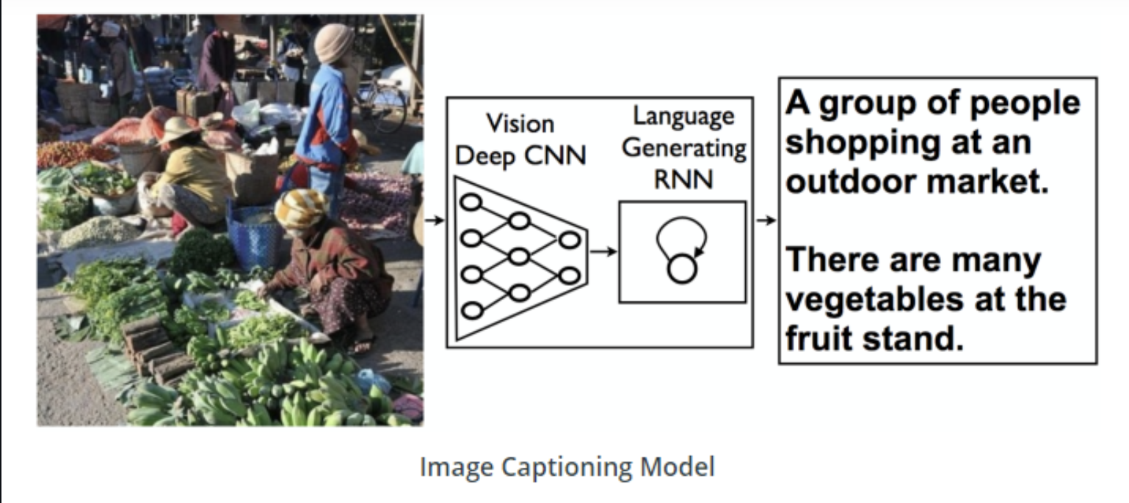
MODEL ARCHITECTURE
The picture describes the high–level architecture of the image captioning model.
We’ll get further deep as we go along the implementation of the model

Slide 10
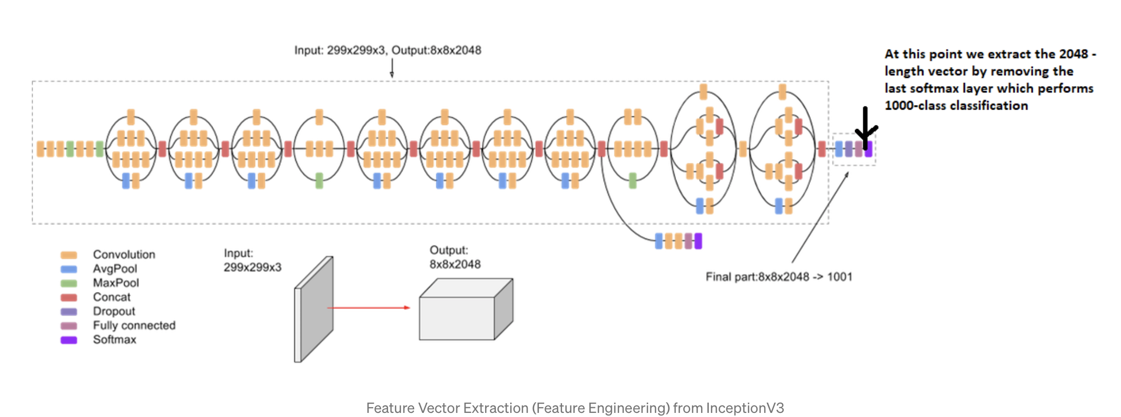




MODEL ARCHITECTURE OF INCEPTIONV3- A Transfer Learning model
Notes:
Images are nothing but input (X) to our model. Any input to a model must be given in the form of a vector.
We use transfer learning by using the InceptionV3 model (Convolutional Neural Network) created by Google Research for this purpose.
This model was trained on Imagenet dataset to perform image classification on 1000 different classes of images. We are interested in getting fixed-length informative vector for each image. This process is called automatic feature engineering.
Thus, we remove the last softmax layer from the model and extract a 2048 length vector (bottleneck features) for every image as shown. We pass every image to this model to get the corresponding 2048 length feature vector as follows

Slide 11
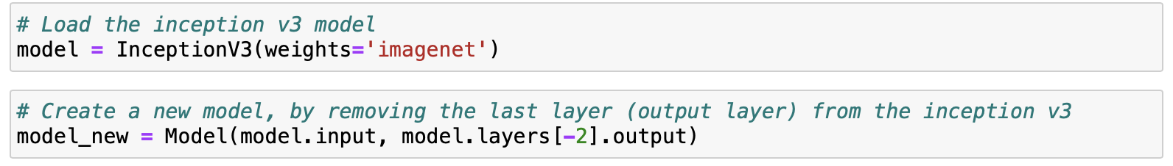
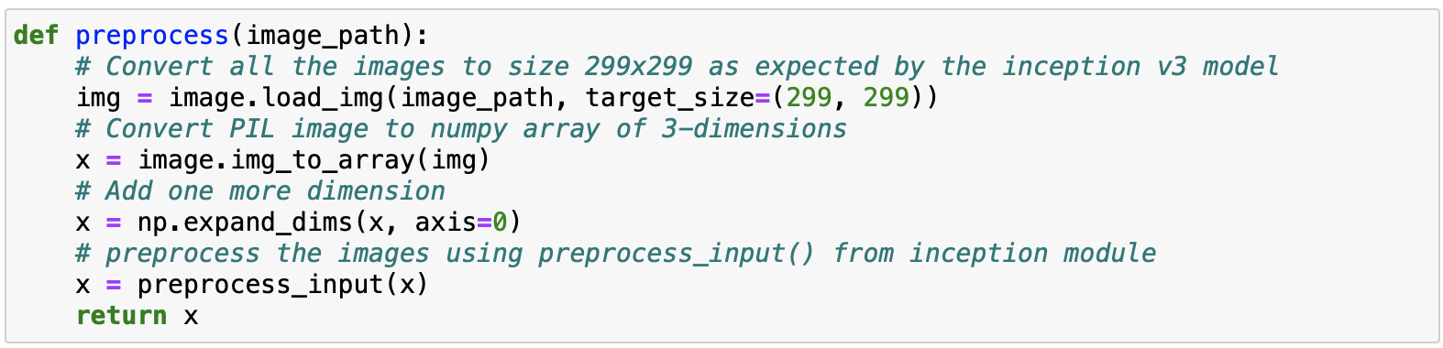
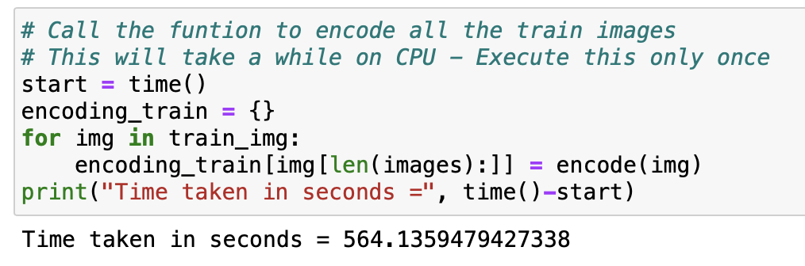
Loading the InceptionV3 model that is trained in ImageNet dataset
Data preprocessing
Training and saving the encoded training images
Test images also follow similar way
Notes:
All the bottleneck train features in a Python dictionary and save it on the disk using Pickle file, namely “encoded_train_images.pkl” whose keys are image names and values are corresponding 2048 length feature vector. This is going to take some time. Length = 6000
Similarly, we encode all the test images and save them in the file “encoded_test_images.pkl” of Length = 1000

Slide 12
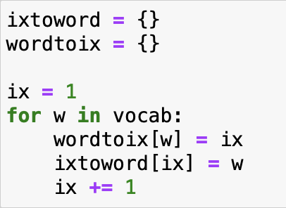
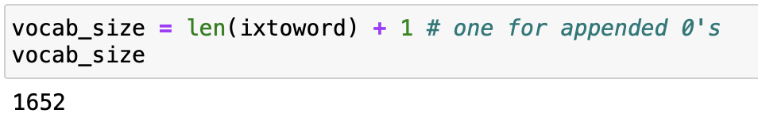
WORD2VEC
Objective is to create captions/textual data. To achieve this, we have to convert words to vector.
We will predict the caption word by word. Thus, we need to encode each word into a fixed sized vector.
We represent every unique word in the vocabulary by an integer (index). We have 1652 unique words in the corpus
Notes:
wordtoix[‘abc’] -> returns index of the word ‘abc’
ixtoword[k] -> returns the word whose index is ‘k’

Slide 13
DATA PREPARATION
How do we frame this as a supervised learning problem?
What does the data matrix look like?
How many data points do we have?
Firstly, we need to convert all the images to their corresponding 2048 length feature vector
Secondly, build the vocabulary for the first two (train) captions by adding the two tokens “startseq” and “endseq”
Caption_1 -> “startseq the black cat sat on grass endseq”
Caption_2 -> “startseq the white cat is walking on road endseq”
vocab = {black, cat, endseq, grass, is, on, road, sat, startseq, the, walking, white}
black -1, cat -2, endseq -3, grass -4, is -5, on -6, road -7, sat -8, startseq -9, the -10, walking -11, white -12
Notes:
append a start token as “startSeq” and end token as “endSeq” to each caption’s start and end respectively, so as to make our model understand where the caption starts and where it ends. Basically, used as a start point and end point.

Slide 14
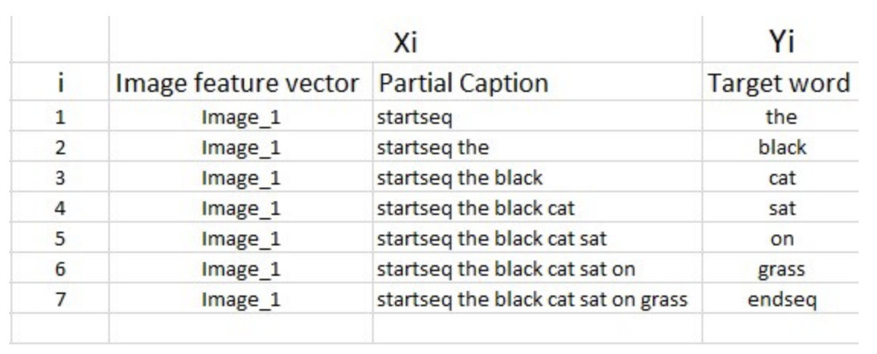
TRAINING SEQUENCE
Image vector is the input, and the caption is what we need to predict.
We provide the image vector and the first word as input and try to predict the second word, i.e.:
Input = Image_1 + ‘startseq’; Output = ‘the’
Then we provide image vector and the first two words as input and try to predict the third word, i.e.:
Input = Image_1 + ‘startseq the’; Output = ‘cat’
And so on…
It’s not just the image which goes as input to the system, but also, a partial caption which helps to predict the next word in the sequence.

Slide 15
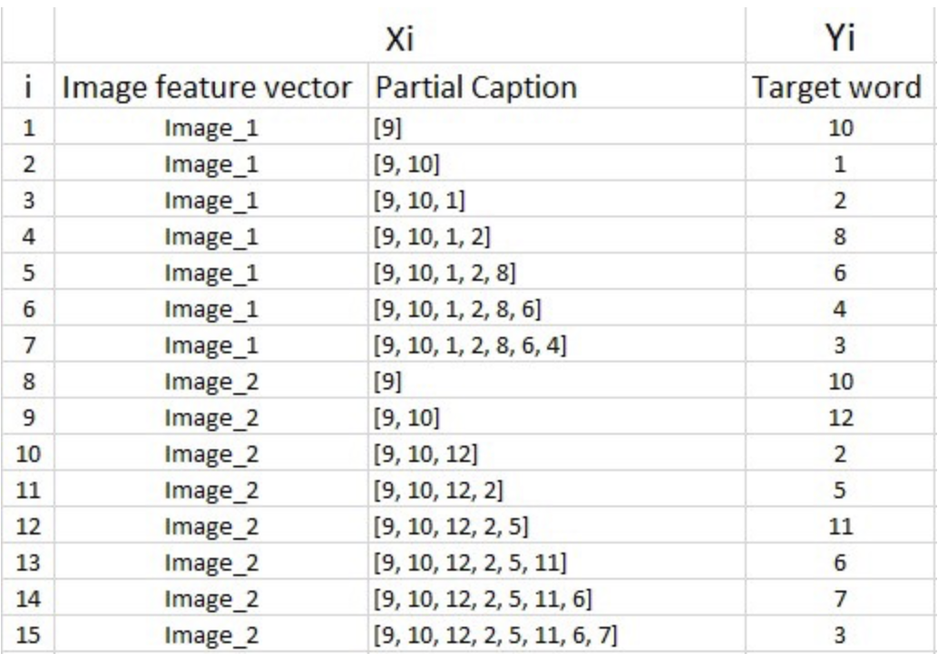
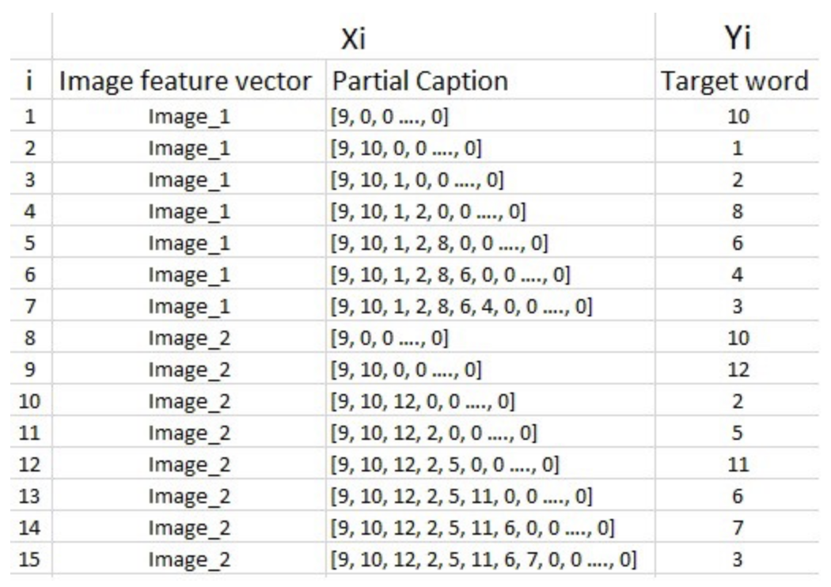
We are not going to pass the actual English text of the caption, rather we are going to pass the sequence of indices where each index represents a unique word.
Create an index for each word, let’s now replace the words with their indices. It looks like the following:
Notes:
we need to make sure that each sequence is of equal length. Hence we need to append 0’s (zero padding) at the end of each sequence. But how many zeros should we append in each sequence?
Well, this is the reason we had calculated the maximum length of a caption, which is 34 in this case. So we will append those many number of zeros which will lead to every sequence having a length of 34.

Slide 16
WHY DATA GENERATOR?
Actual training dataset we have 6000 images, each having 5 captions. This makes a total of 30000 images and captions.
Even if we assume that each caption on an average is just 7 words long, it will lead to a total of 30000*7 i.e., 210000 data points.
Size of the data matrix = n*m
Where n-> number of data points (assumed as 210000)
And m-> length of each data point
Clearly m= Length of image vector(2048) + Length of partial caption(x).
m = 2048 + x
But what is the value of x? Well, you might think it is 34, but no wait, it’s wrong.
Every word (or index) will be mapped (embedded) to higher dimensional space through one of the word embedding techniques.

Slide 17
WORD EMBEDDING
Each word/index is mapped to a 50-long vector using a pre-trained GLOVE word embedding model
Now each sequence contains 34 indices, where each index is a vector of length 50. Therefore x = 34*50 = 1700
Thus, m = 3748
And this size of the data matrix = 210000 * 3748 = 787080000 blocks which is very huge and may require more than 3 GB of main memory and a lot of load on RAM, making the system slow.
For this reason, we use data generators a lot in Deep Learning.
With SGD, we do not calculate the loss on the entire data set to update the gradients. Rather in every iteration, we calculate the loss on a batch of data points (typically 64, 128, 256, etc.) to update the gradients.
Notes:
This means that we do not require to store the entire dataset in the memory at once. Even if we have the current batch of points in the memory, it is sufficient for our purpose.
A generator function in Python is used exactly for this purpose. It’s like an iterator which resumes the functionality from the point it left the last time it was called.

Slide 18
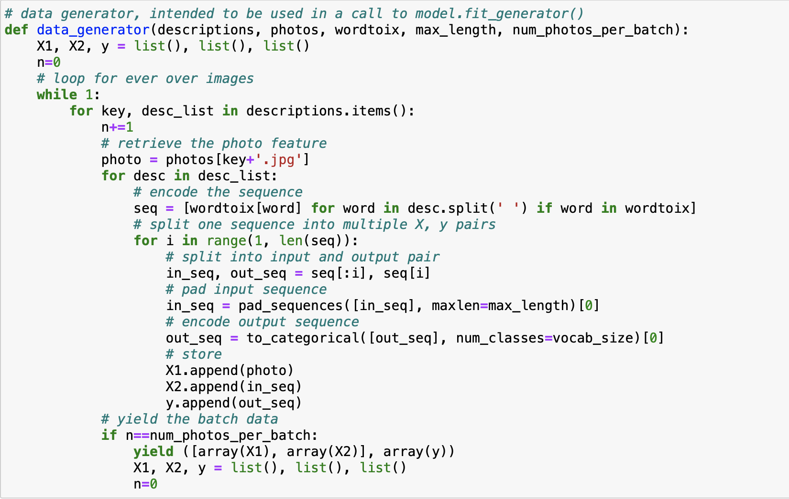
DATA GENERATOR CODE

Slide 19
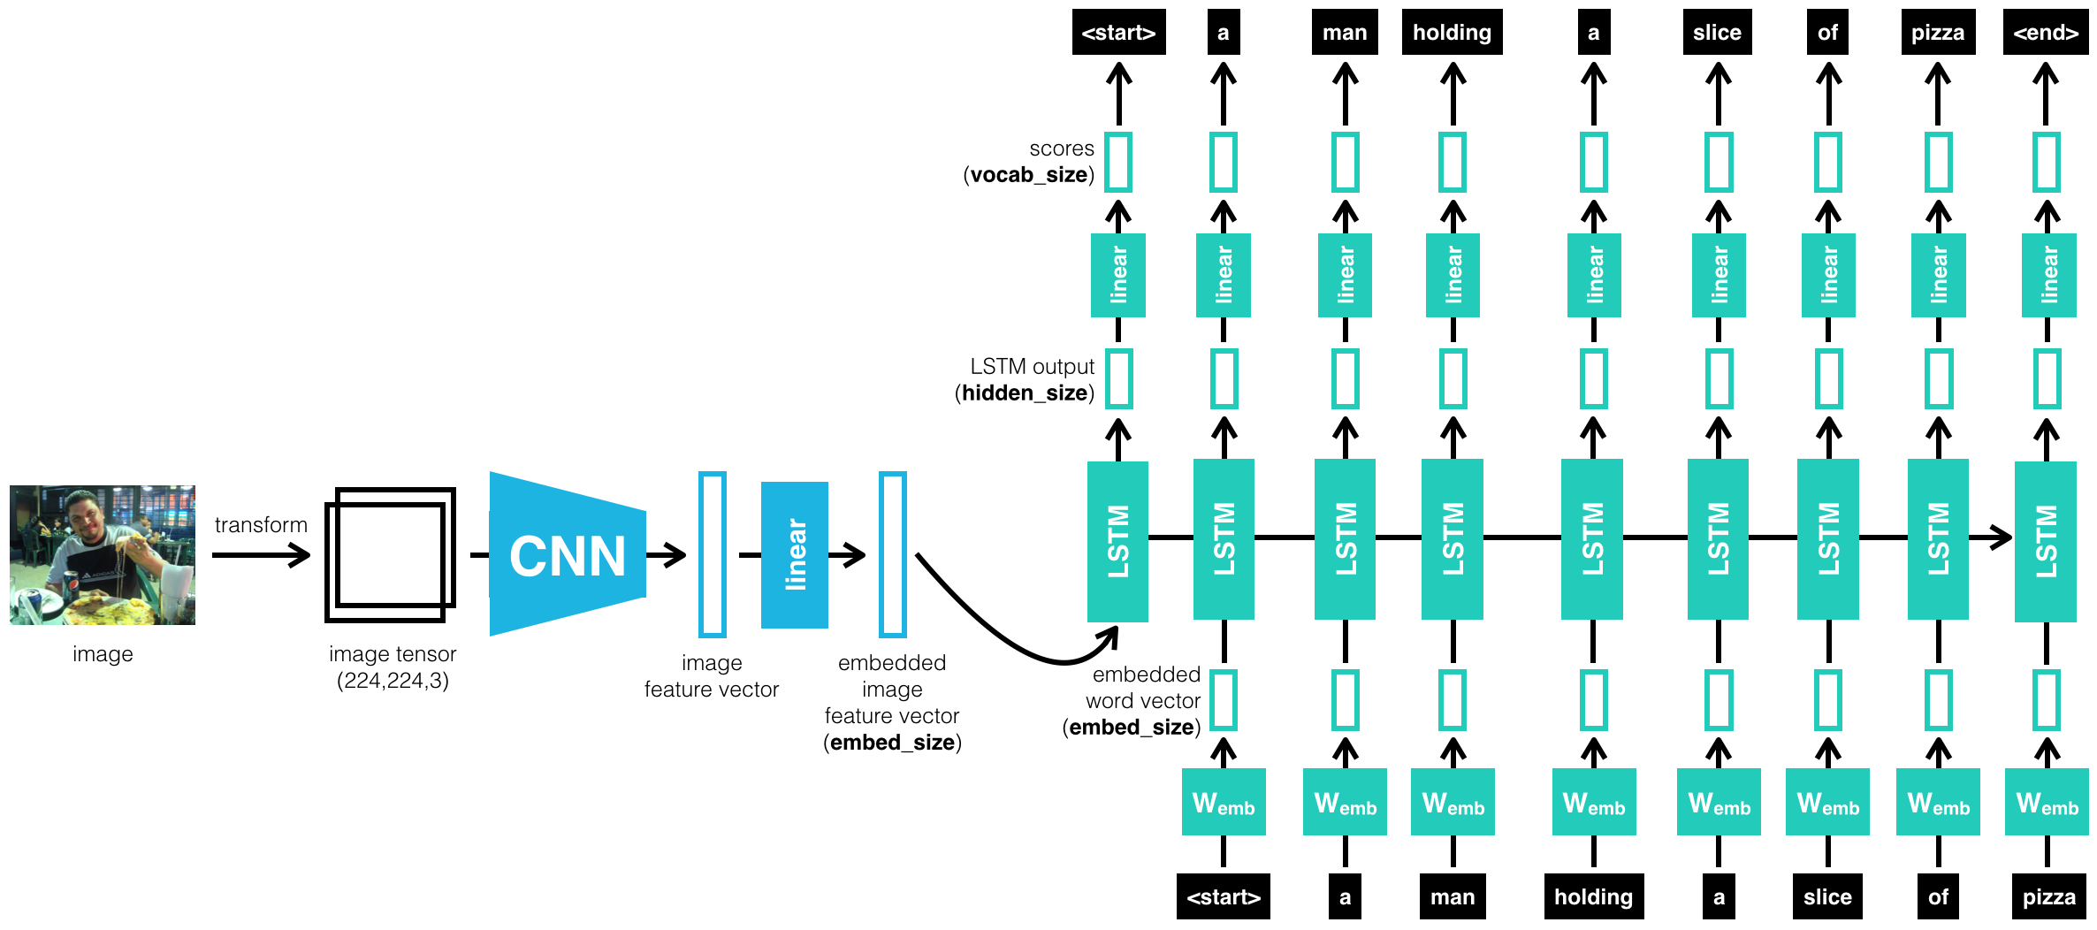
ENCODER-DECODER MODEL

Slide 20
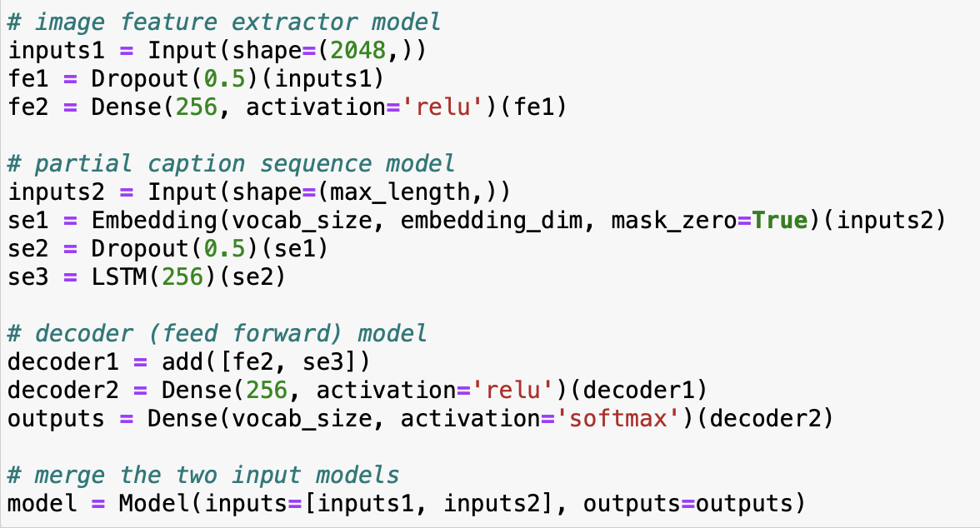
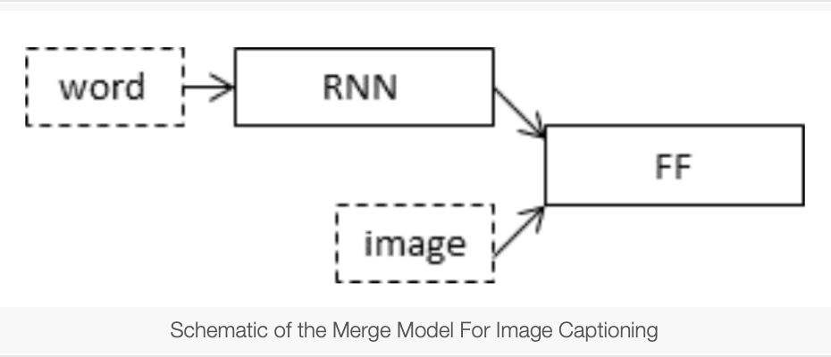
Notes:
Photo Feature Extractor. This is a InceptionV3 model pre-trained on the ImageNet dataset. We have pre-processed the photos with the InceptionV3 model (without the output layer) and will use the extracted features predicted by this model as input.
Sequence Processor. This is a word embedding layer for handling the text input, followed by a Long Short-Term Memory (LSTM) recurrent neural network layer.
Decoder Both the feature extractor and sequence processor output a fixed-length vector. These are merged together and processed by a Dense layer to make a final prediction.

Slide 21
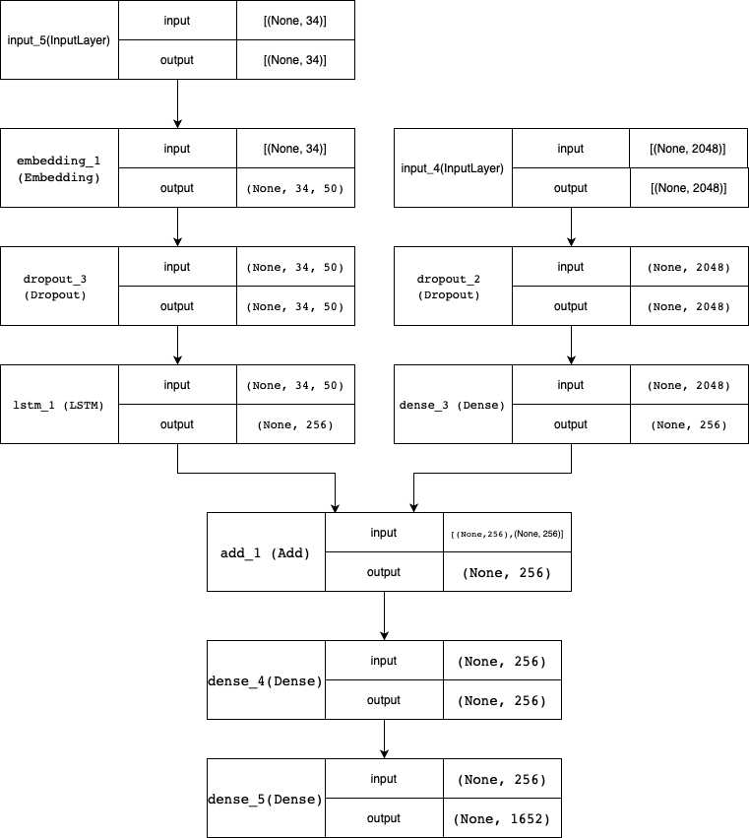
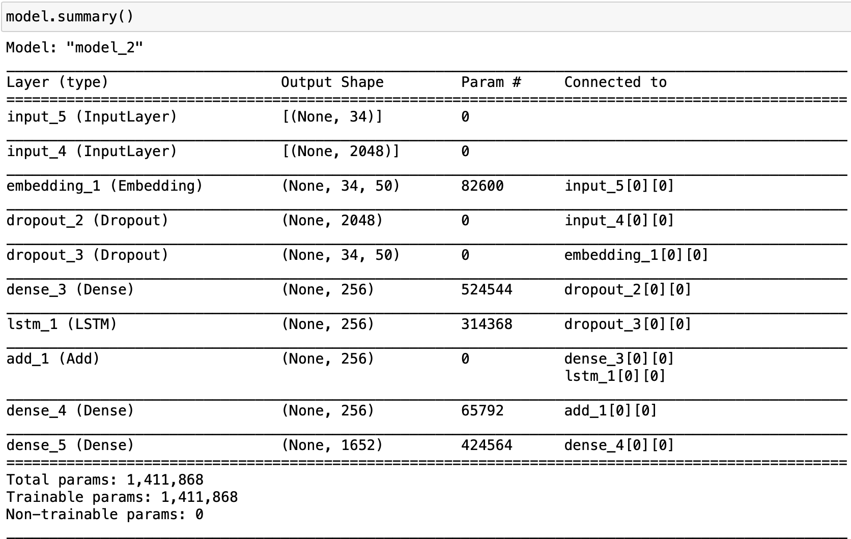

Slide 22
HYPERPARAMETER TUNING
The model was then trained for 30 epochs with the initial learning rate of 0.001 and 3 pictures per batch (batch size). However, after 20 epochs, the learning rate was reduced to 0.0001 and the model was trained on 6 pictures per batch.
This generally makes sense because during the later stages of training, since the model is moving towards convergence, we must lower the learning rate so that we take smaller steps towards the minima. Also increasing the batch size over time helps your gradient updates to be more powerful.

Slide 23
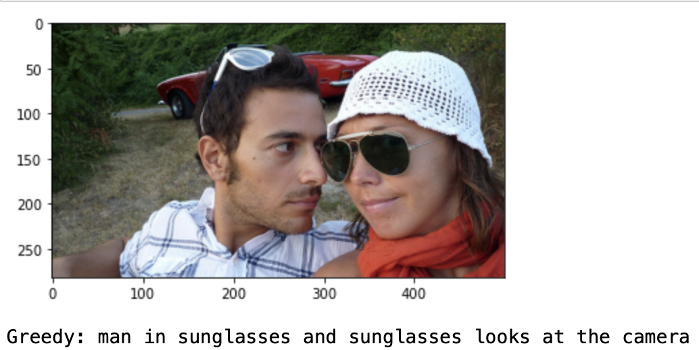
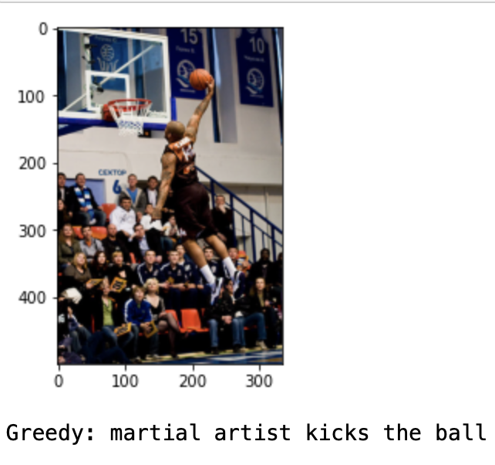
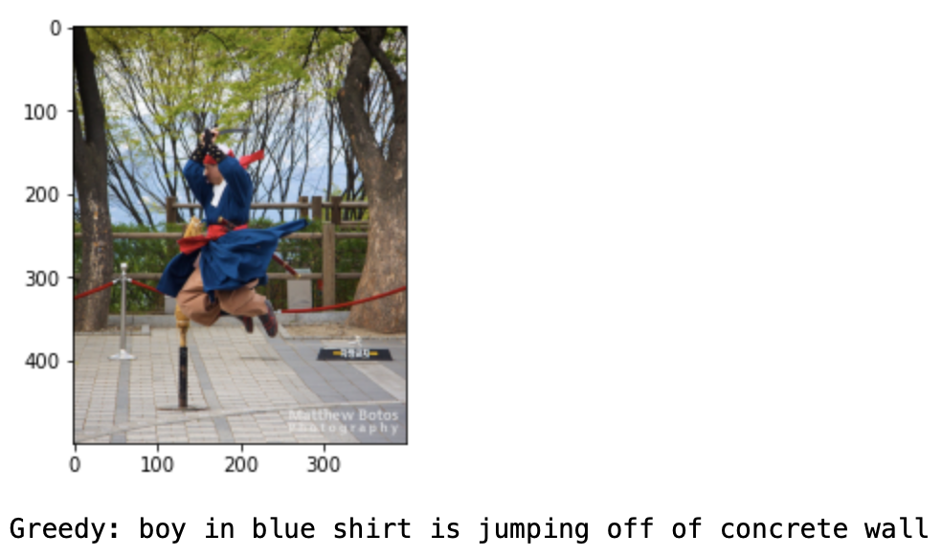
EVALUATION

Slide 24
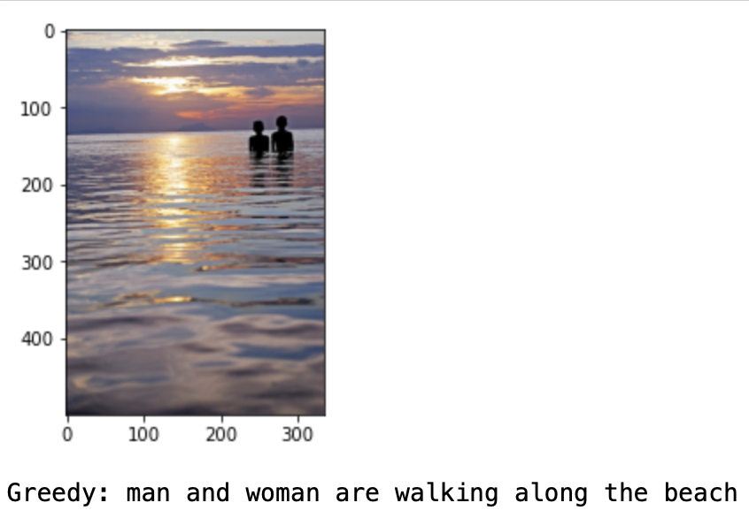
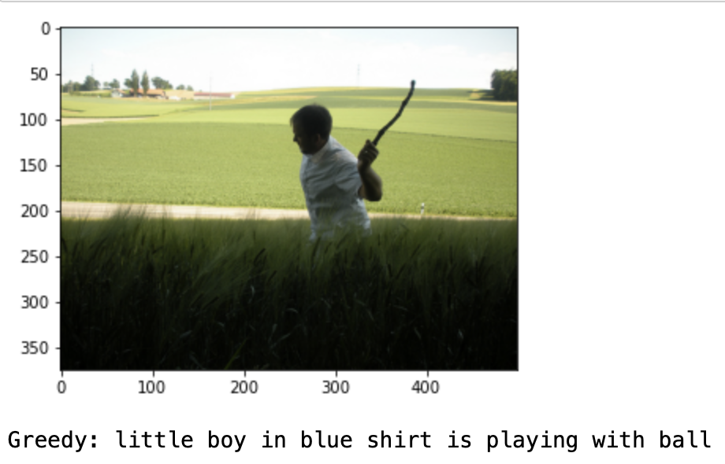

Slide 25
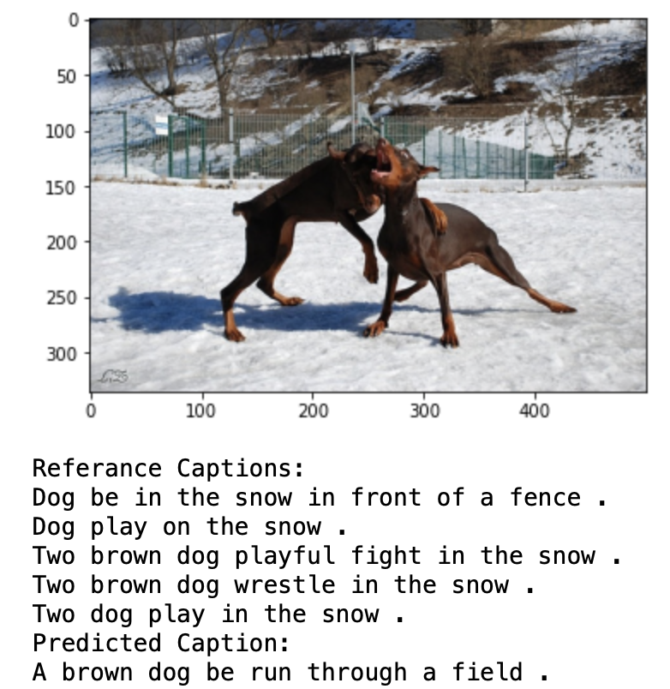
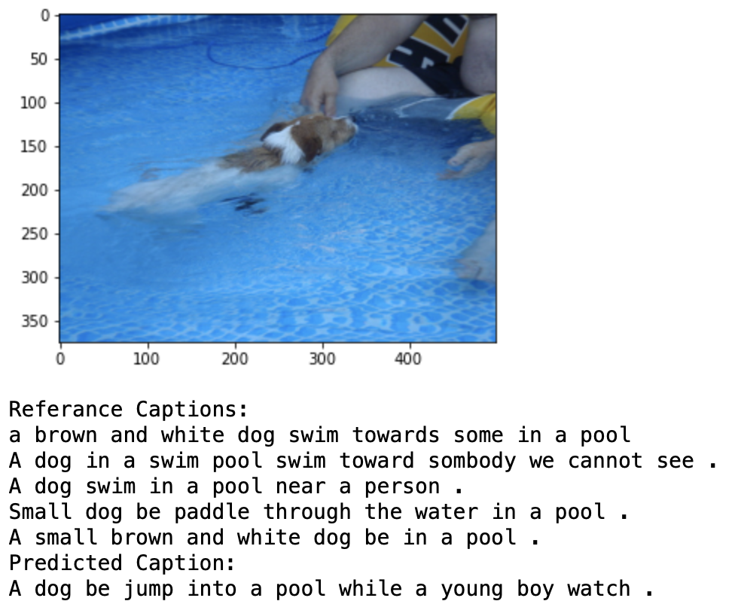
RESULTS FROM USING OTHER PRETRAINED MODEL

Slide 26
CONCLUSION AND FUTURE DIRECTIONS
Results may vary given the stochastic nature of the algorithm or evaluation procedure, or differences in numerical precision.
Using a larger dataset like MS-COCO and trying to run on GPU/TPU
Doing more hyper parameter tuning (learning rate, batch size, number of layers, number of units, dropout rate, batch normalization etc.).
Use the cross validation set to understand overfitting.
My next challenge is:
Writing the code in a proper object-oriented way so that it becomes easier for others to replicate
Using Beam Search instead of Greedy Search during Inference.
Using BLEU Score to evaluate and measure the performance of the model.

Slide 27
REFERENCES
https://machinelearningmastery.com/develop-a-deep-learning-caption-generation-model-in-python/
https://machinelearningmastery.com/prepare-photo-caption-dataset-training-deep-learning-model/
https://www.youtube.com/watch?v=yk6XDFm3J2c

